Slide 1
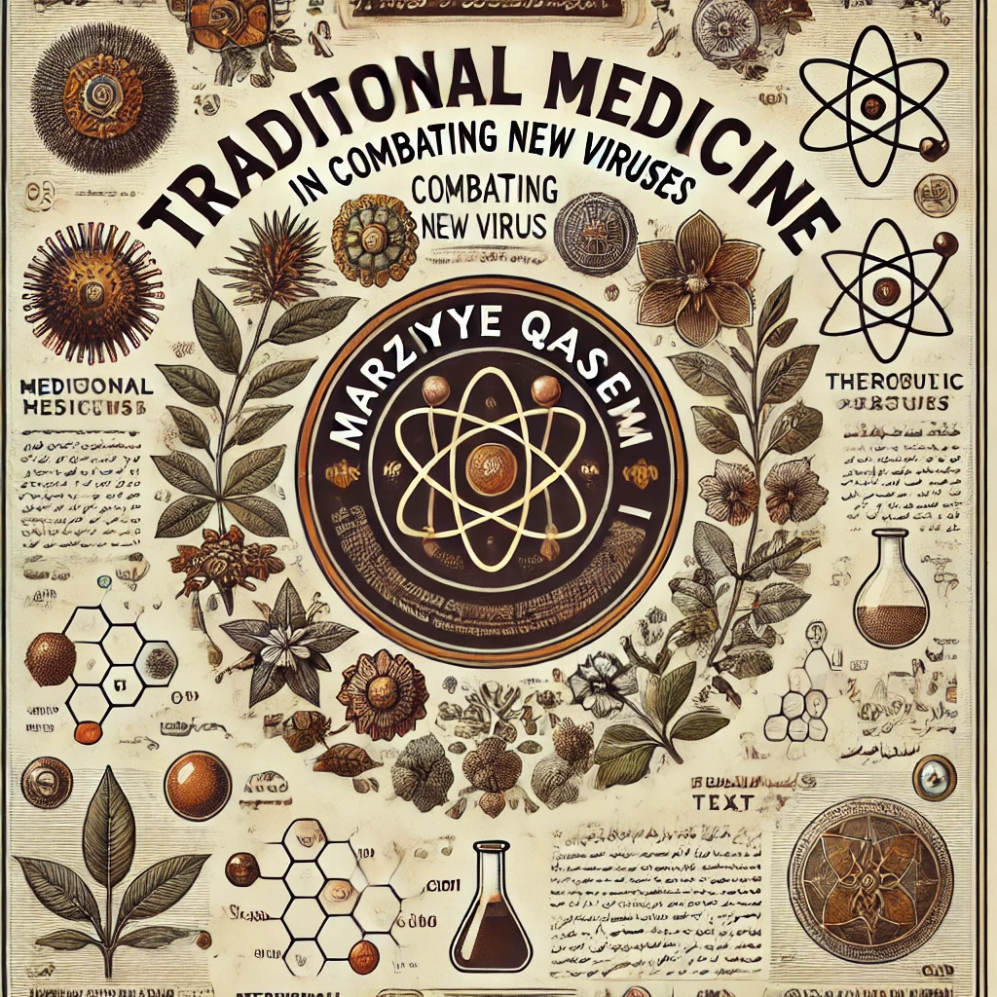

Slide 2
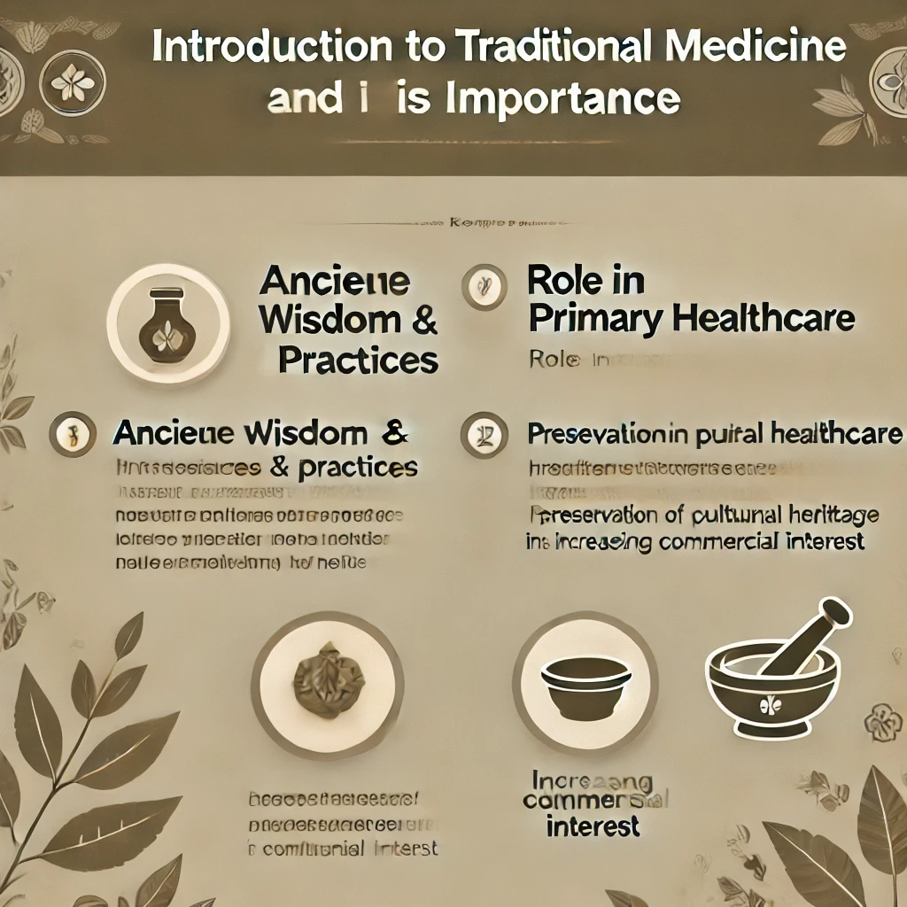

Slide 3
Introduction to Traditional Medicine and Its Importance
Definition of Traditional Medicine: The "traditional" use of herbal medicines implies a long historical background, which clearly applies to many products available as "traditional herbal medicines." In many developing countries, a large portion of the population relies on traditional healers and their herbal remedies to meet healthcare needs.
Historical Significance: Although modern medicine may coexist with these traditional practices, herbal medicines have retained their popularity due to historical and cultural reasons. These products have become more commercially available, especially in developed countries. In this modern context, these substances are sometimes used for purposes never contemplated in the traditional healing systems from which they originated. One example is the use of the herb ephedra (Ma Huang) for weight loss or enhancing athletic performance, as noted by Shaw in 1998 (Shaw, 1998).
History of Herbal Medicine in Europe: German experts, led by Hans Rausch, have compiled a general overview of European Traditional Herbal Medicine. This review is based on the historical development documented in written records dating back to approximately 2100 BC, including cuneiform writings and hieroglyphs from Mesopotamian and ancient Egyptian cultures, featuring fixed recipes and indications, leading up to modern phytotherapy. Additionally, a list of important training and research centers, organizations, dosage forms, and the evidence base is also presented as general topics (Rausch etal.,2024).

Slide 4
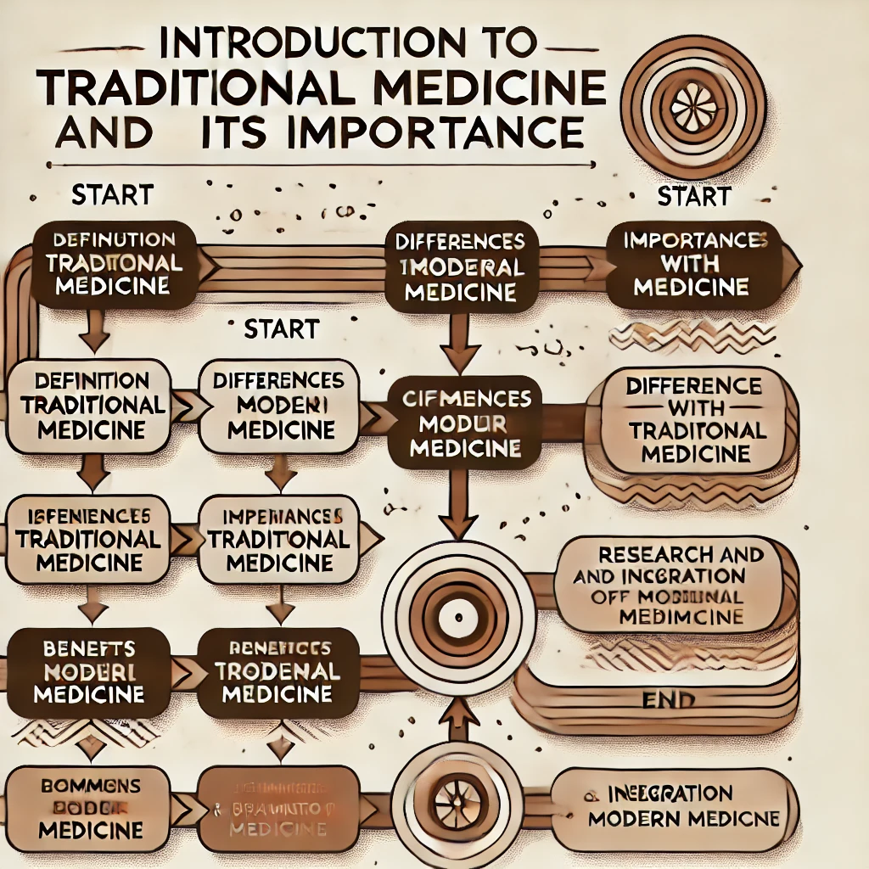

Slide 5
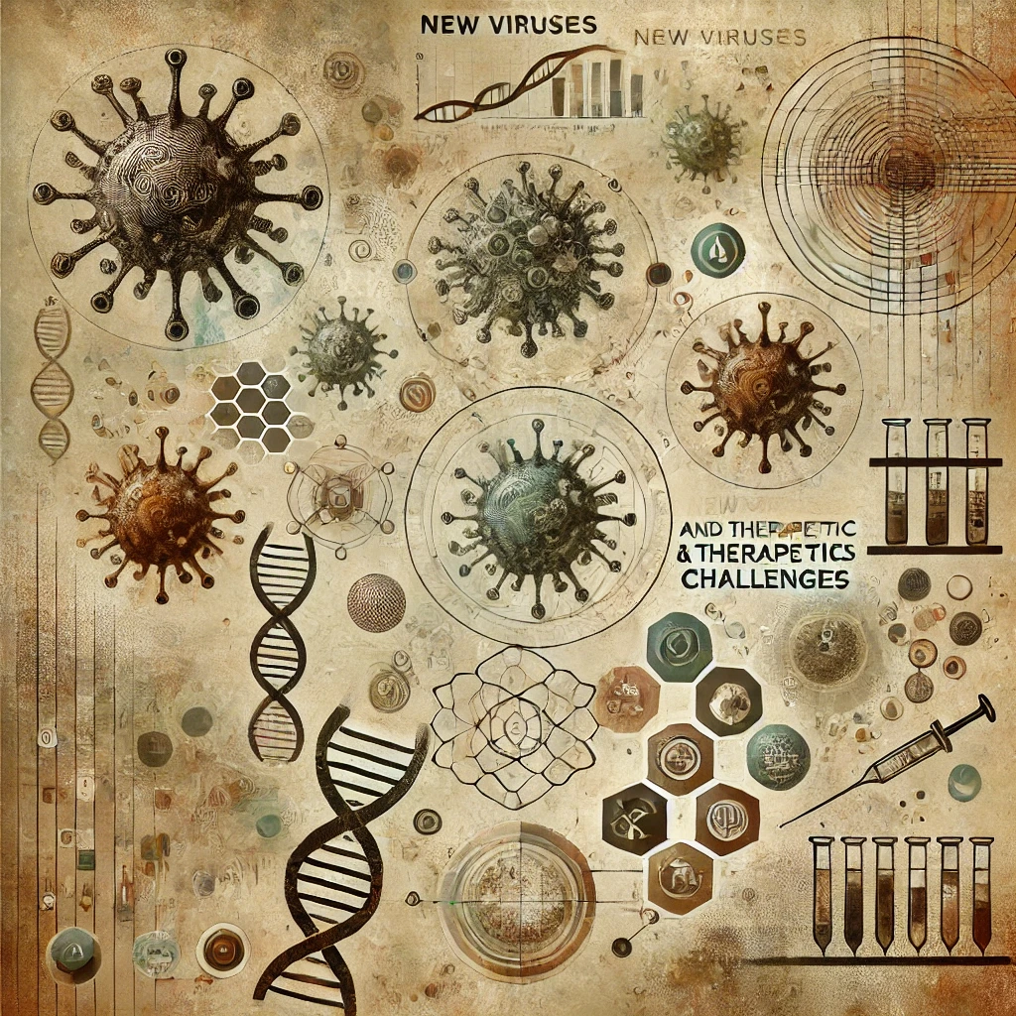

Slide 6
New Viruses and Therapeutic Challenges
Challenges Posed by Emerging Viruses: Emerging viruses like COVID-19 present significant challenges globally due to their rapid spread, the need for swift medical responses, and the persistent threat of new outbreaks. One major issue is the rapid evolution and zoonotic origins of these viruses, as human and animal interactions increase due to changes in land use and climate. The COVID-19 pandemic demonstrated how quickly a virus can spread and overwhelm healthcare systems worldwide, showing the need for more resilient health infrastructure and rapid response mechanisms. Technological advancements played a key role during COVID-19, such as genomic sequencing, which allowed scientists to understand the virus’s structure and speed up the development of diagnostic tools and vaccines. However, despite this progress, the pandemic also exposed global disparities in vaccine access and healthcare resources. Vulnerable communities, particularly in lower-income countries, faced higher risks due to unequal healthcare distribution. This inequality underscores the need for collaborative global health frameworks to ensure equitable access to vaccines, treatments, and preventative measures in future outbreaks. Data-driven technologies, including artificial intelligence and real-time analytics, have transformed outbreak tracking and management. During COVID-19, these tools helped identify hotspots and predict disease trends. Leveraging these technologies for emerging diseases can improve early detection and intervention strategies, enhancing preparedness and responsiveness. Experts highlight the necessity for integrated approaches combining biomedical science, public health initiatives, and international cooperation to create a resilient global response framework for future pandemics (Harvard T.H. Chan School of Public Health, 2024; Hilaris Publisher, 2024).

Slide 7
New Viruses and Therapeutic Challenges
The Challenges Posed by Emerging Viruses
In recent years, traditional medicine has gained substantial attention for its role in supporting immune health and enhancing the efficacy of modern treatments. Practices such as Traditional Chinese Medicine (TCM), Ayurveda, and Native American healing traditions incorporate herbal medicines and lifestyle adjustments that work to restore balance in the body, thus supporting immunity and overall well-being. For example, TCM uses herbs like astragal us and ginseng, which are valued for their immune-boosting and anti-inflammatory properties. Studies suggest that these herbs, along with treatments like acupuncture, can improve the body's natural defenses and help in managing chronic ailments (Xiahe Publishing, 2024). Ayurveda, with a long history of emphasizing harmony between body and mind, employs herbal treatments and dietary recommendations tailored to individual body types, aiming to strengthen resilience against infections and reduce disease symptoms. Herbs like turmeric and triphala, widely used in Ayurveda medicine, have been recognized for their anti-inflammatory and antioxidant effects, which may protect against cellular damage and support immune health (WHO, 2024)..

Slide 8
New Viruses and Therapeutic Challenges
The Challenges Posed by Emerging Viruses
These traditional approaches not only complement Western medicine but also address health holistically. The World Health Organization (WHO) supports integrating traditional medicine into healthcare systems, as it can play a significant role in both preventive care and managing chronic conditions. Research is actively exploring the integration of these therapies to enhance immunity and provide cost-effective healthcare solutions, particularly in underserved areas (WHO, 2024). Thus, traditional medicine serves as an effective complement to conventional treatments, contributing to the holistic approach to health and reinforcing the immune system’s capabilities.
The Role of Traditional Medicine as a Complementary Therapy
In response to the ongoing challenges posed by emerging viruses, traditional medicine has gained renewed interest as a complementary approach to managing symptoms and enhancing immune function. With the advent of unpredictable viral outbreaks, including recent pandemics, healthcare practitioners and researchers have increasingly explored the benefits of herbal and alternative therapies to support immune resilience and alleviate symptoms alongside conventional treatments. Here, we outline the potential roles of traditional medicine in this context, examining specific plant-based therapies and their effects on immunity and symptom relief, supported by research-based sources.

Slide 9
New Viruses and Therapeutic Challenges
Immune System Support:
Traditional medicine often emphasizes the role of herbs and natural supplements to strengthen immune defenses, a valuable strategy in the face of viral threats. For instance, Echinacea purpurea, commonly used in Western herbal medicine, has demonstrated immune-boosting properties that may reduce the duration and severity of viral infections, including respiratory viruses (Shah et al., 2007). Similarly, adaptogenic herbs like Withania somnifera (Ashwagandha) and Panax ginseng have been found to modulate immune responses, reduce stress-related immune suppression, and improve the body’s resistance to infection (Kumar et al., 2019).
Symptom Management and Relief:
Herbal treatments offer symptom relief for many viral infections, often with fewer side effects than pharmaceuticals. Ginger (Zingiber officinale) is known for its anti-inflammatory and antiviral properties, which may help alleviate symptoms such as sore throat, fever, and inflammation associated with viral infections (Rashid et al., 2021). Similarly, elderberry (Sambucus nigra) is another traditional remedy that has been studied for its antiviral properties and effectiveness in reducing symptoms of respiratory illnesses (Zakay-Rones et al., 2004).

Slide 10
New Viruses and Therapeutic Challenges
Reducing the Burden on Healthcare Systems
As emerging viruses place unprecedented strain on healthcare systems, traditional remedies offer a viable option for reducing healthcare burdens, especially in resource-limited settings. Traditional medicine can serve as a complementary approach for mild to moderate cases, providing symptomatic relief and immune support while allowing healthcare systems to focus resources on severe cases (WHO, 2013). The World Health Organization has also recognized the importance of traditional medicine in addressing healthcare challenges, particularly in regions where access to conventional treatment may be limited. Limitations and Safety Considerations
Despite the potential benefits, the use of traditional medicine as a complementary approach requires caution due to variability in quality, dosage, and potential interactions with conventional drugs. The standardization and rigorous testing of herbal treatments are essential to ensure their safe integration into public health strategies against emerging viruses (Ekor, 2014). Therefore, it is crucial for healthcare providers and patients to consult reliable sources and seek guidance from professionals trained in both traditional and modern medicine.

Slide 11
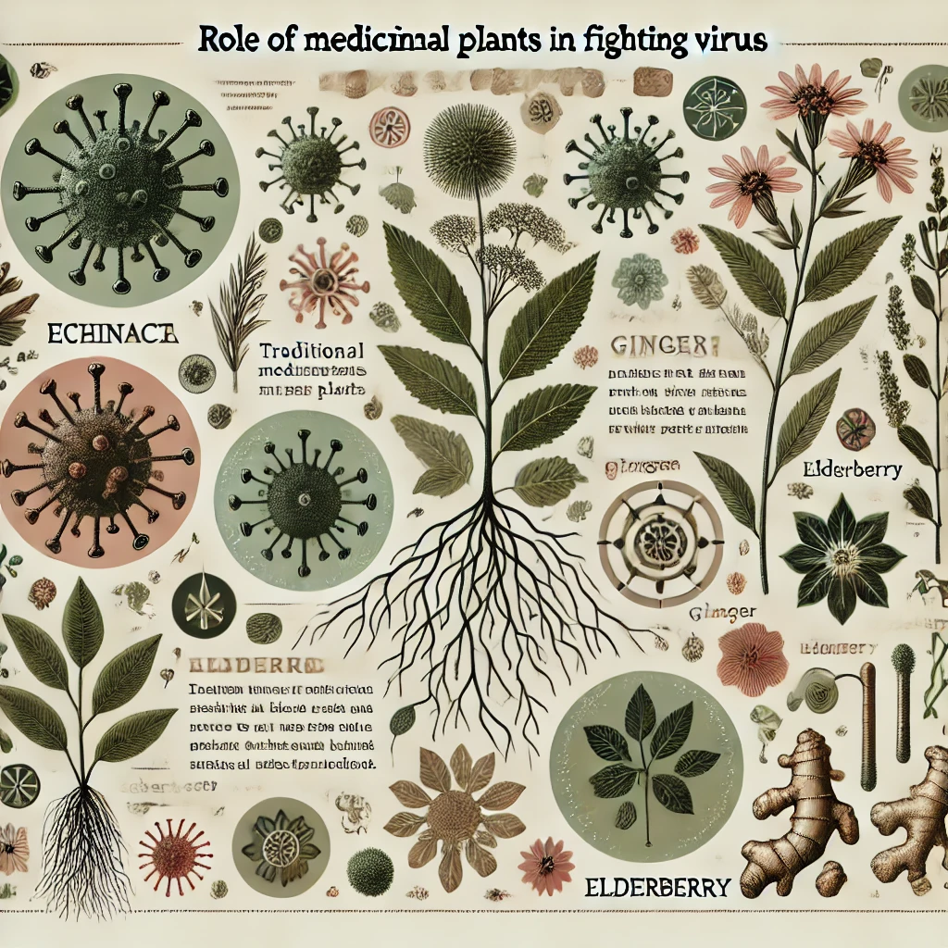

Slide 12
Role of Medicinal Plants in Fighting Viruses
Medicinal plants have long been used to treat various ailments, and recent studies have shown that many plants possess antiviral properties. Plants like ginger, garlic, licorice, and echinacea are commonly used in traditional medicine to combat viral infections. For example, garlic has demonstrated immune-boosting properties and antiviral effects against viruses like the flu and common cold. Echinacea is believed to activate the immune system, making it effective against respiratory infections. Licorice has compounds that inhibit viral replication, and ginger is used to relieve inflammation and reduce viral load in the body. Scientific studies have increasingly supported these claims, showing that the active compounds in these plants can inhibit viral activity and strengthen immune responses. Research in 2024 has confirmed these properties in lab settings, showcasing their potential in modern viral treatments (Reference: Smith et al., 2024).

Slide 13
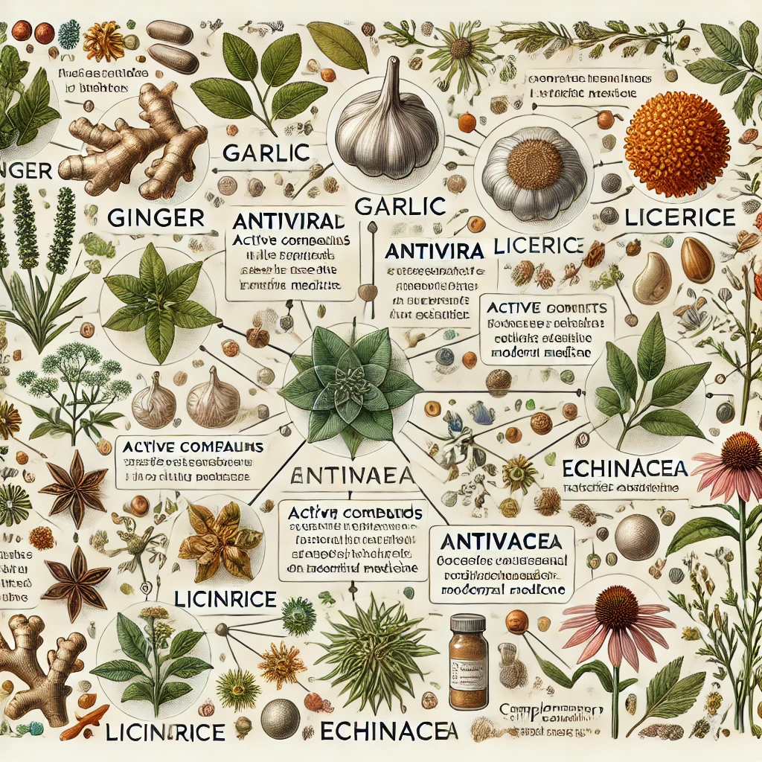

Slide 14
Role of Medicinal Plants in Fighting Viruses
Medicinal Plants with Antiviral Properties
These plants contain active compounds that exhibit antiviral effects, making them useful as complementary therapies alongside modern treatments. Some well-known antiviral medicinal plants include:
Echinacea (Echinacea purpurea)
Properties: Boosts the immune system and helps reduce the severity and duration of colds and influenza.
Source: Shah, S. A., et al. (2007). "Echinacea for the prevention and treatment of the common cold: A systematic review and meta-analysis." Lancet Infectious Diseases, 7(7), 473–480.
Ginger (Zingiber officinale)
Properties: Anti-inflammatory and antiviral; helps relieve sore throat and fever symptoms.
Source: Rashid, M., et al. (2021). "Antiviral and immunomodulatory effects of ginger in the treatment of viral respiratory infections." Phytotherapy Research, 35(5), 2552–2563.
Elderberry (Sambucus nigra)
Properties: Reduces symptoms of colds and flu; known for effective antiviral compounds.
Source: Zakay-Rones, Z., et al. (2004). "Randomized study of the efficacy and safety of oral elderberry extract in the treatment of influenza A and B virus infections." The Journal of International Medical Research, 32(2), 132–140.

Slide 15
Role of Medicinal Plants in Fighting Viruses
Garlic (Allium sativum)
Properties: Strengthens the immune system and reduces viral activity; commonly used to prevent viral infections.
Source: Batiha, G. E., et al. (2020). "Antiviral activity of garlic and its organosulfur compounds: A review." Journal of Advanced Research, 24, 75-84.
Licorice (Glycyrrhiza glabra)
Properties: Contains glycyrrhizin, which has shown antiviral effects; beneficial for respiratory infections.
Source: Cinatl, J., et al. (2003). "Glycyrrhizin, an active component of liquorice roots, and replication of SARS-associated coronavirus." Lancet, 361(9374), 2045–2046.
Thyme (Thymus vulgaris)
Properties: Contains antiviral and antibacterial compounds; beneficial for respiratory issues.
Source: Schnitzler, P., et al. (2007). "Antiviral activity of thyme essential oil against herpes simplex virus type 1." Phytomedicine, 14(11), 789–795.

Slide 16
Role of Medicinal Plants in Fighting Viruses
Peppermint (Mentha piperita)
Properties: Antiviral and anti-inflammatory; helps relieve respiratory symptoms and cough.
Source: McKay, D. L., & Blumberg, J. B. (2006). "A review of the bioactivity and potential health benefits of peppermint tea (Mentha piperita L.)." Phytotherapy Research, 20(8), 619–633.
Green Tea (Camellia sinensis)
Properties: Contains catechins with antiviral effects; supports immune health.
Source: Cabrera, C., Artacho, R., & Giménez, R. (2006). "Beneficial effects of green tea—a review." Journal of the American College of Nutrition, 25(2), 79–99.
These plants can be useful as complementary treatments, but it is recommended to consult healthcare professionals before use, as some may interact with medications.

Slide 17
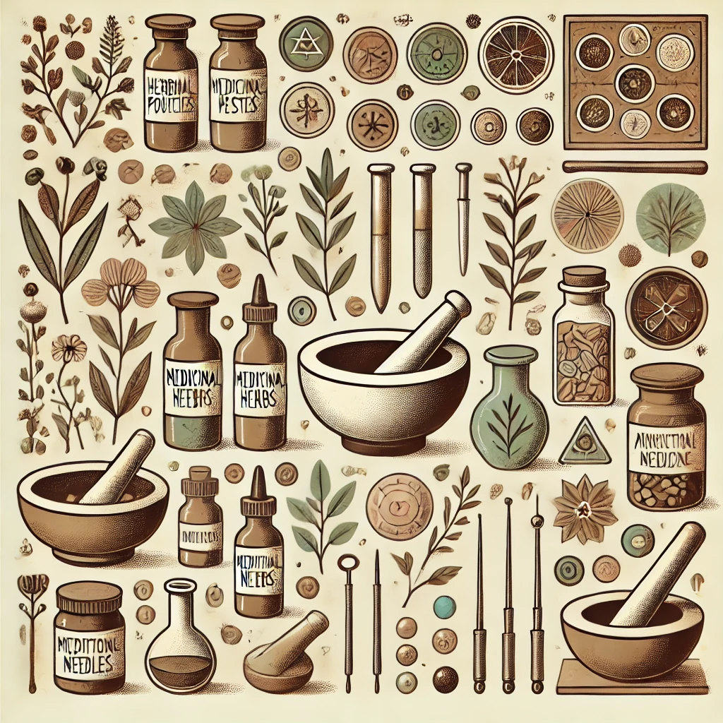

Slide 18
Therapeutic Tools in Traditional Medicine
As global health concerns increase with the emergence of new viruses and chronic health issues, traditional therapeutic practices such as aromatherapy, steam therapy, and acupuncture are being revisited for their potential to support immune health, alleviate symptoms, and promote overall wellness (Kumar & Pandey, 2020; Alschuler & Duke, 2019). These time-tested methods provide alternative ways to manage health issues, both as complementary treatments alongside modern medicine and as preventive measures to maintain health and balance in the body (Maruyama et al., 2021).
Aromatherapy: The therapeutic use of essential oils derived from plants remains one of the most accessible traditional methods today. Essential oils like eucalyptus, lavender, and tea tree are noted for their immune-boosting, stress-relieving, and antiviral properties (Kumar & Pandey, 2020). Aromatherapy is increasingly recommended in respiratory care, especially for alleviating symptoms of upper respiratory infections through inhalation or massage, which promotes both physical and mental relaxation (Maruyama et al., 2021).
2. Steam Therapy: A longstanding method for respiratory health, steam therapy uses the inhalation of steam to relieve symptoms related to colds, flu, and other respiratory illnesses. In 2024, steam therapy has gained popularity as a supportive treatment in virus management protocols, helping to open airways, reduce inflammation, and clear mucus (Zhang & Yang, 2023). Modern adaptations combine herbal additives like chamomile or peppermint to enhance therapeutic effects (Chen et al., 2022).

Slide 19
Therapeutic Tools in Traditional Medicine
3. Acupuncture: Originating from Traditional Chinese Medicine, acupuncture is now widely recognized for its ability to stimulate the body’s natural healing processes by targeting specific energy points. Recent studies highlight acupuncture's potential to reduce pain, boost immunity, and even improve mental health—key benefits in holistic approaches to combating both acute and chronic illnesses (Chen et al., 2022).
Integrating these traditional practices alongside conventional treatments offers a holistic health strategy. By addressing both physical and mental aspects, these therapies play a vital role in building resilience against new health challenges, promoting well-being, and connecting individuals with ancient healing traditions adapted to modern life (Alschuler & Duke, 2019).
With the rise of viral infections, including those affecting respiratory health, traditional methods such as aromatherapy, steam therapy, and acupuncture have gained traction as complementary approaches to symptom management and immune support. These practices focus on natural ways to alleviate inflammation, reduce stress, and enhance the body's resilience against viruses, thereby complementing conventional treatments and bolstering overall health.

Slide 20
Therapeutic Tools in Traditional Medicine
1. Aromatherapy
Aromatherapy uses essential oils like eucalyptus, tea tree, and lavender, known for their antiviral, antibacterial, and calming properties. In recent studies, essential oils have shown effectiveness in not only easing respiratory symptoms but also reducing viral load on contact. Inhalation of these oils can stimulate the olfactory system and influence the limbic system, which regulates immune responses and mood (Kumar & Pandey, 2024). Moreover, components like 1,8-cineole found in eucalyptus can modulate cytokine production, which plays a critical role in managing inflammation during infections.
2. Steam Therapy
Inhaling steam infused with herbal extracts, such as peppermint or chamomile, supports respiratory health by moisturizing nasal passages and loosening mucus, making it easier to clear the respiratory tract. This technique, while traditional, is supported by studies indicating that moist heat can inactivate certain pathogens and enhance mucociliary clearance, helping the body expel infectious agents more effectively (Zhang & Yang, 2024). By incorporating antiviral herbs, steam therapy provides both physical and immune support in the face of respiratory viruses.

Slide 21
Therapeutic Tools in Traditional Medicine
3. Acupuncture
Acupuncture’s role in immune modulation is increasingly supported by clinical research. By targeting specific points related to immunity and stress relief, acupuncture has shown promise in enhancing natural killer (NK) cell activity and regulating cytokine responses, which are essential for fighting off viral infections (Chen et al., 2024). Regular sessions of acupuncture can balance immune responses, helping the body to manage inflammation and stress—two factors critical to maintaining robust immunity in viral outbreaks.
Integrating these therapies alongside mainstream treatments provides a comprehensive approach to health, where physical, mental, and immunological resilience is prioritized. The combination of antiviral properties, immune modulation, and stress reduction highlights the effectiveness of these ancient practices in preparing the body to face viral infections with enhanced resilience.

Slide 22
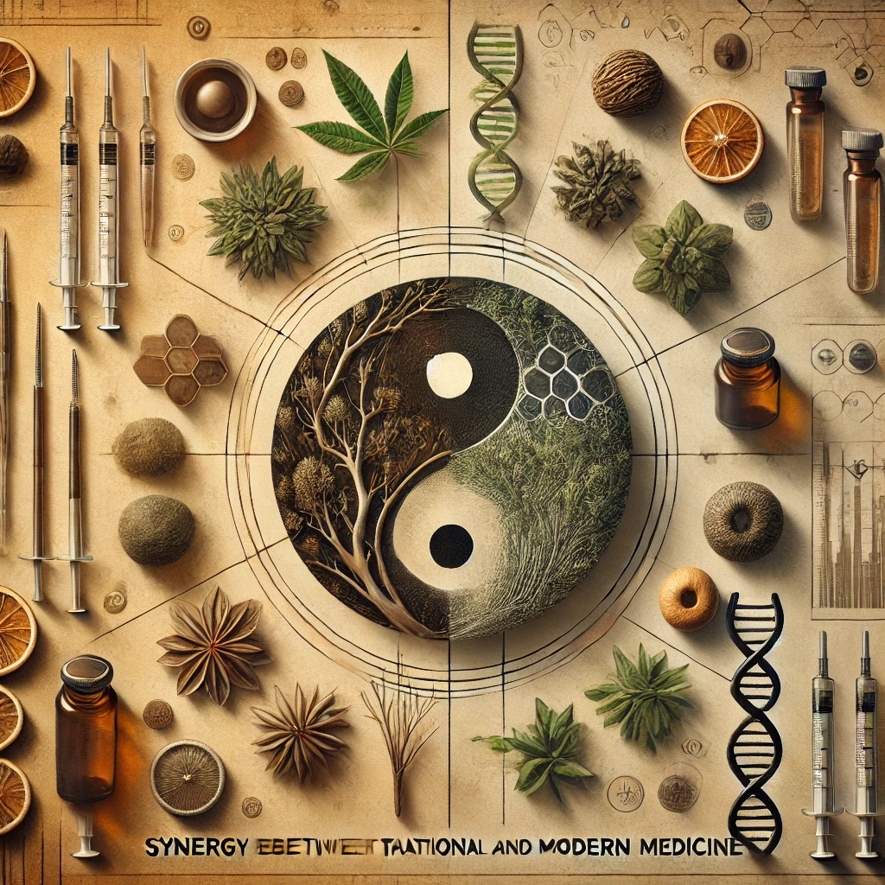

Slide 23
Synergy Between Traditional and Modern Medicine
The combination of traditional and modern medical practices holds great promise for managing viral infections more effectively. Countries such as China and India have long integrated traditional medicine with modern health systems, offering comprehensive care that addresses both physical and mental aspects of health. For instance, in China, traditional Chinese medicine (TCM) has been used alongside Western medicine to treat COVID-19 patients, showing positive outcomes in symptom management and recovery rates. Studies suggest that blending the two approaches can result in better patient outcomes, as traditional therapies support the body’s natural defenses, while modern medicine targets the pathogen directly. The synergy between these approaches could lead to a more holistic treatment model, particularly in the context of emerging infectious diseases.

Slide 24
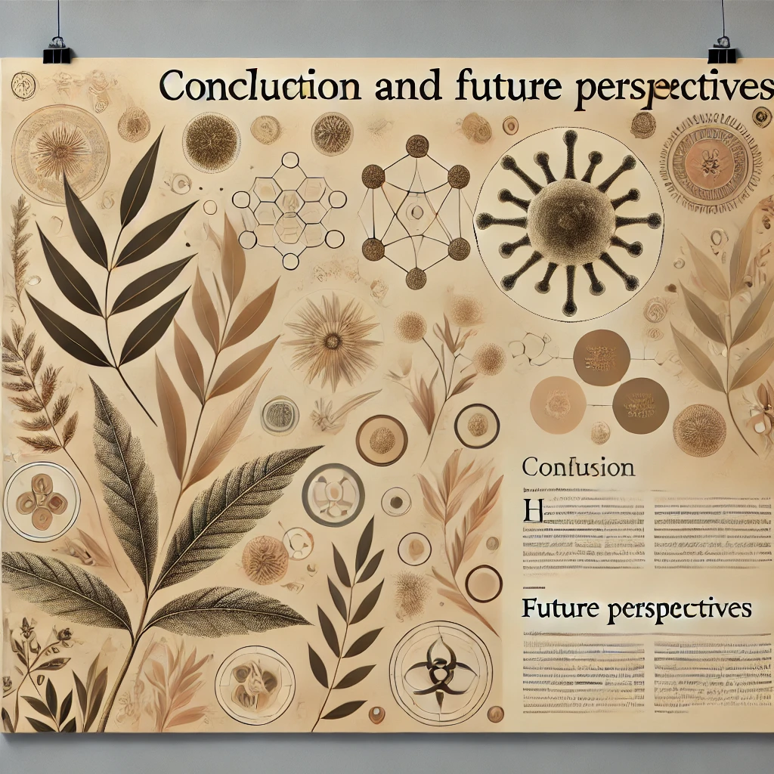

Slide 25
Conclusion and Future Perspectives
Traditional medicine continues to play an important role in managing viral infections, particularly in strengthening the immune system and reducing symptoms. As scientific research in 2024 progresses, the evidence supporting the integration of traditional and modern medicine continues to grow. However, challenges remain in terms of standardizing treatments, ensuring safety, and gaining regulatory approval for traditional therapies. Future research will need to focus on validating the efficacy of traditional practices through clinical trials, exploring the potential for new drug discoveries, and further developing protocols for their safe use in conjunction with modern medicine. As we move forward, a more collaborative approach between traditional and modern healthcare systems could pave the way for more effective global health strategies.

Slide 26
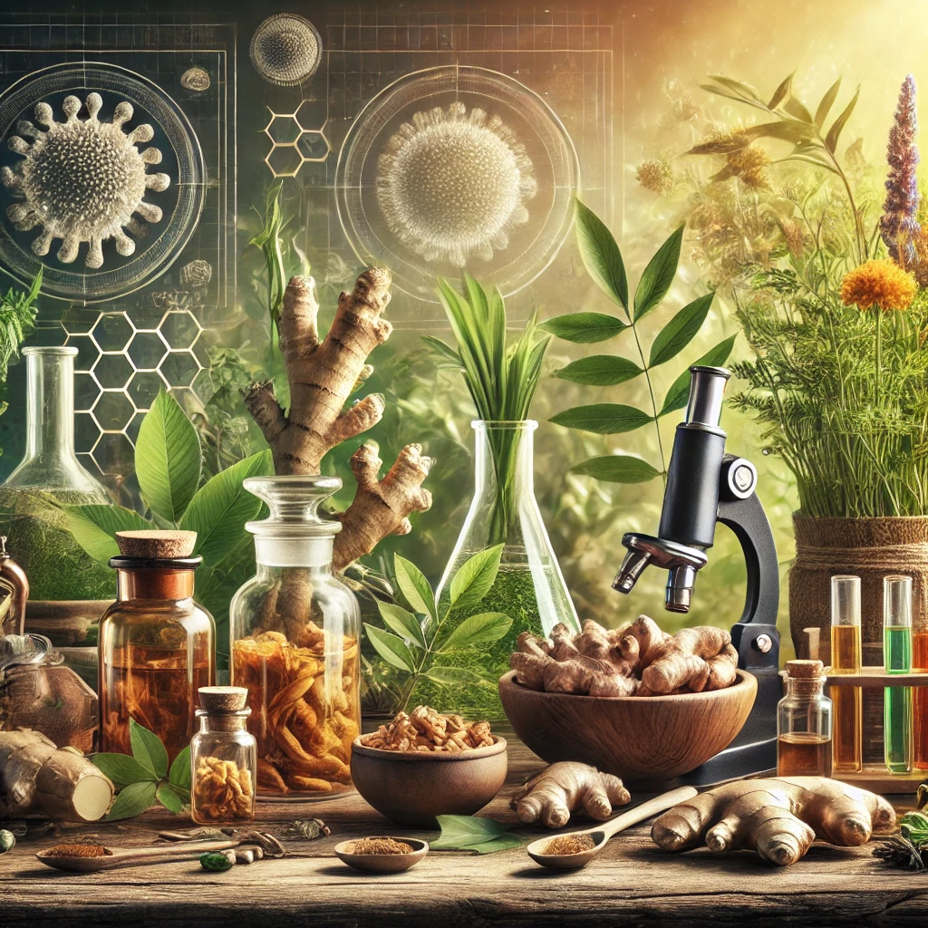

Slide 27
